Slide 1

Fire Alarm System
Aditi 20191IST0002
Aniket Mohapatra 20191IST0010
Saya Vamshi Krishna 20191IST0198

Slide 2

Introduction
We have seen many typical Fire Alarm projects which will alert with a siren or an automatic shutdown mechanism . This fire alarm project make use of modern communication technologies to deal with emergencies.
The main AIM of this project is to develop a system based on embedded micro controller , which is used to protect electrical appliances in home and using Led and audible alarm system.

Slide 3

Objectives
Fire Detection
Occupants Alerted to The Fire
Helps to Manage Risks
Notifies the Authorities

Slide 4
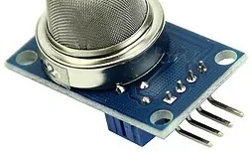

Hardware Requirements
Arduino UNO board
LM-35 Temperature Sensor
Gas sensor
Resistors
Breadboard
Led
Piezo Buzzer
Jumper Wires

Slide 5
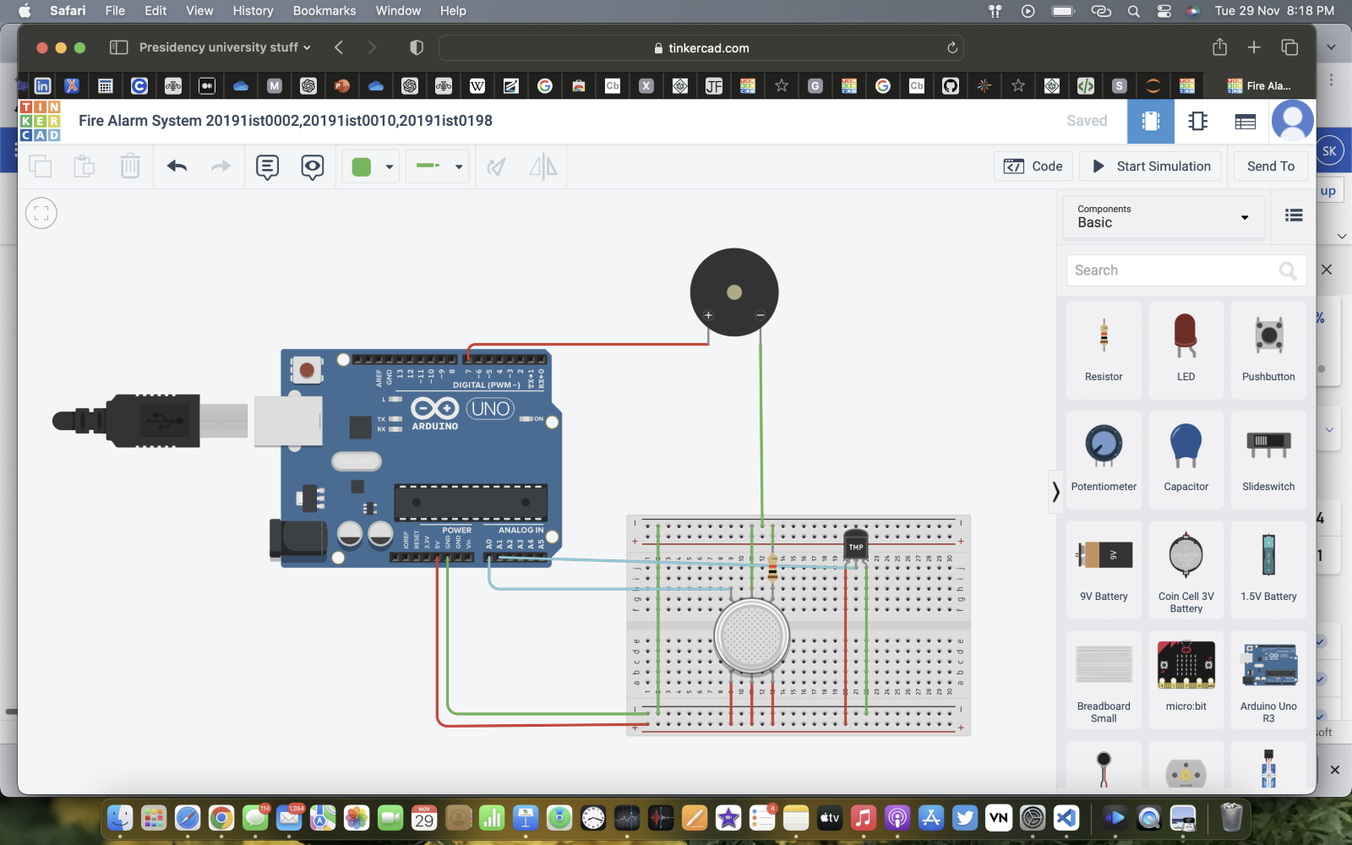
Circuit

Slide 6
Code
//convert voltage value to temperature in Celsius
temp=vo1*100;
gas_sensor=analogRead(A0);
if(temp>=80){
digitalWrite(led,HIGH);
digitalWrite(buz,HIGH);
}
else{
digitalWrite(led,LOW);
digitalWrite(buz,LOW);
}
if(gas_sensor>=100){
digitalWrite(led,HIGH);
digitalWrite(buz,HIGH);
}
else{
digitalWrite(led,LOW);
digitalWrite(buz,LOW);
}
float temp;
float vo;
float vo1;
int gas_sensor;
int buz=7;
void setup(){
pinMode(A1,INPUT);
pinMode(buz,OUTPUT);
Serial.begin(9600);
}
void loop(){
vo=analogRead(A1);
//Convert the raw data value(0 - 1023) to voltage(0.0V - 5.0V)
vo1=vo*(5.0/1023.0);

Slide 7
Code (cont.)
Serial.print("temperature in C =");
Serial.print(" ");
Serial.print(temp);
Serial.print(" ");
Serial.print("Gas Sensor =");
Serial.print(" ");
Serial.print(gas_sensor);
Serial.println();
delay(500);
}

Slide 8
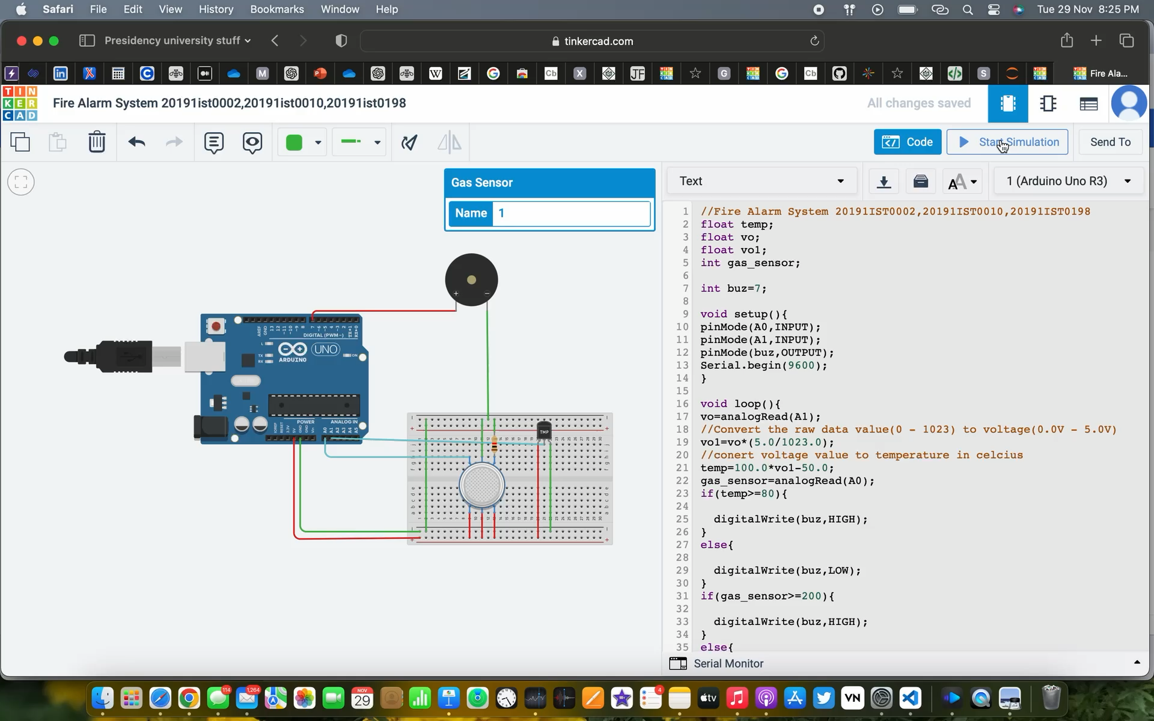
Simulation

Slide 9







Advantages & Disadvantages
Detection Distance
Sensitivity
Narrow field of vision
Expensive
Speed of Response
Reliability
Difficult to Maintain

Slide 10




Applications
Home Security System
School/College Lab
Small Scale Industries
Hydrogen gas station

Slide 11
Thank you.

